Slide 1
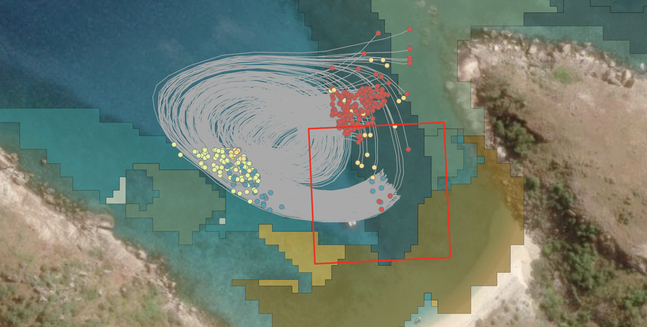
coralseed: a spatially explicit model of larval reseeding
RRAP Moving Corals subprogram
Notes:
In terms of upscaling larval restoration, the hydrodynamic models have been able to provide insight into one of the key questions of larval reseeding: where do larvae disperse following release?
From 10's of millions of larvae released onto damaged reefscduring free releases, how many settle in the immediate area and what are the spillover effects into adjacent habitats?
Where do larvae settle following release? This is important in terms of covnerting numbers of larvae into expected densities as a production rate, but ultiamtely quantifying the spatial footprtint of restoration.
To quantify this, we developed 'coralseed', a spatially explicit probabilistic model of larval settlement that leverages the high resolution dispersal models
So, coralseed is an individual based model, from smallscale simulations to large-scale modelling of releases
It's spatially explicit, incorporating habitat maps and larval particle tracks
It adopts a bayesian framework so is probabilitstic in terms of determining settlement outcomes
It's parameterised on field and experimental data collected during the RRAP program.
coralseed is split into four components: the underlying dispersal model, larval competency (how long after release are they ready to settle), a stochastic component of mortality (for example predation), and finally settlement success based upon where larvae track and probabilty of settlement.

Slide 2
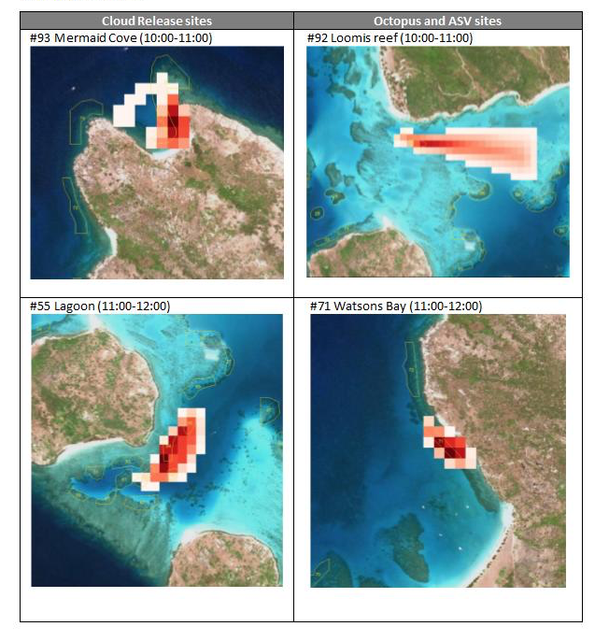
Larval reseeding
Where do larvae disperse?
Notes:
In terms of upscaling larval restoration, the hydrodynamic models have been able to provide insight into one of the key questions of larval reseeding: where do larvae disperse following release?
From 10's of millions of larvae released onto damaged reefscduring free releases, how many settle in the immediate area and what are the spillover effects into adjacent habitats?
Where do larvae settle following release? This is important in terms of covnerting numbers of larvae into expected densities as a production rate, but ultiamtely quantifying the spatial footprtint of restoration.
To quantify this, we developed 'coralseed', a spatially explicit probabilistic model of larval settlement that leverages the high resolution dispersal models
So, coralseed is an individual based model, from smallscale simulations to large-scale modelling of releases
It's spatially explicit, incorporating habitat maps and larval particle tracks
It adopts a bayesian framework so is probabilitstic in terms of determining settlement outcomes
It's parameterised on field and experimental data collected during the RRAP program.
coralseed is split into four components: the underlying dispersal model, larval competency (how long after release are they ready to settle), a stochastic component of mortality (for example predation), and finally settlement success based upon where larvae track and probabilty of settlement.

Slide 3
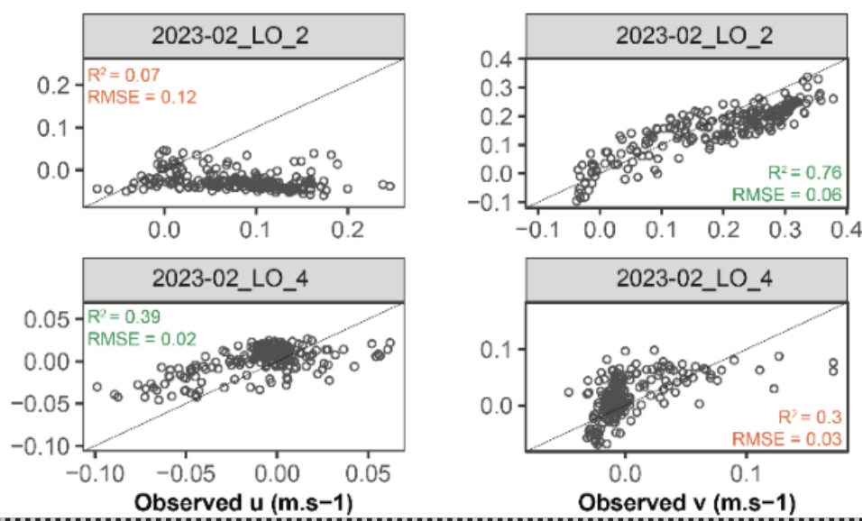
Larval reseeding
Where do larvae disperse?
Notes:
In terms of upscaling larval restoration, the hydrodynamic models have been able to provide insight into one of the key questions of larval reseeding: where do larvae disperse following release?
From 10's of millions of larvae released onto damaged reefscduring free releases, how many settle in the immediate area and what are the spillover effects into adjacent habitats?
Where do larvae settle following release? This is important in terms of covnerting numbers of larvae into expected densities as a production rate, but ultiamtely quantifying the spatial footprtint of restoration.
To quantify this, we developed 'coralseed', a spatially explicit probabilistic model of larval settlement that leverages the high resolution dispersal models
So, coralseed is an individual based model, from smallscale simulations to large-scale modelling of releases
It's spatially explicit, incorporating habitat maps and larval particle tracks
It adopts a bayesian framework so is probabilitstic in terms of determining settlement outcomes
It's parameterised on field and experimental data collected during the RRAP program.
coralseed is split into four components: the underlying dispersal model, larval competency (how long after release are they ready to settle), a stochastic component of mortality (for example predation), and finally settlement success based upon where larvae track and probabilty of settlement.

Slide 4
Larval reseeding
2) Where do larvae settle?
Notes:
In terms of upscaling larval restoration, the hydrodynamic models have been able to provide insight into one of the key questions of larval reseeding: where do larvae disperse following release?
From 10's of millions of larvae released onto damaged reefscduring free releases, how many settle in the immediate area and what are the spillover effects into adjacent habitats?
Where do larvae settle following release? This is important in terms of covnerting numbers of larvae into expected densities as a production rate, but ultiamtely quantifying the spatial footprtint of restoration.
To quantify this, we developed 'coralseed', a spatially explicit probabilistic model of larval settlement that leverages the high resolution dispersal models
So, coralseed is an individual based model, from smallscale simulations to large-scale modelling of releases
It's spatially explicit, incorporating habitat maps and larval particle tracks
It adopts a bayesian framework so is probabilitstic in terms of determining settlement outcomes
It's parameterised on field and experimental data collected during the RRAP program.
coralseed is split into four components: the underlying dispersal model, larval competency (how long after release are they ready to settle), a stochastic component of mortality (for example predation), and finally settlement success based upon where larvae track and probabilty of settlement.

Slide 5
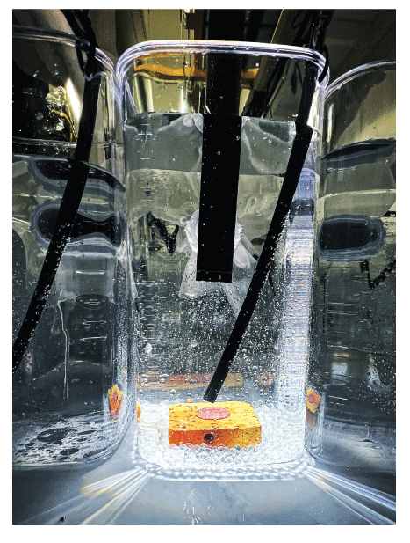
Larval reseeding
2) Where do larvae settle?
Notes:
In terms of upscaling larval restoration, the hydrodynamic models have been able to provide insight into one of the key questions of larval reseeding: where do larvae disperse following release?
From 10's of millions of larvae released onto damaged reefscduring free releases, how many settle in the immediate area and what are the spillover effects into adjacent habitats?
Where do larvae settle following release? This is important in terms of covnerting numbers of larvae into expected densities as a production rate, but ultiamtely quantifying the spatial footprtint of restoration.
To quantify this, we developed 'coralseed', a spatially explicit probabilistic model of larval settlement that leverages the high resolution dispersal models
So, coralseed is an individual based model, from smallscale simulations to large-scale modelling of releases
It's spatially explicit, incorporating habitat maps and larval particle tracks
It adopts a bayesian framework so is probabilitstic in terms of determining settlement outcomes
It's parameterised on field and experimental data collected during the RRAP program.
coralseed is split into four components: the underlying dispersal model, larval competency (how long after release are they ready to settle), a stochastic component of mortality (for example predation), and finally settlement success based upon where larvae track and probabilty of settlement.

Slide 6
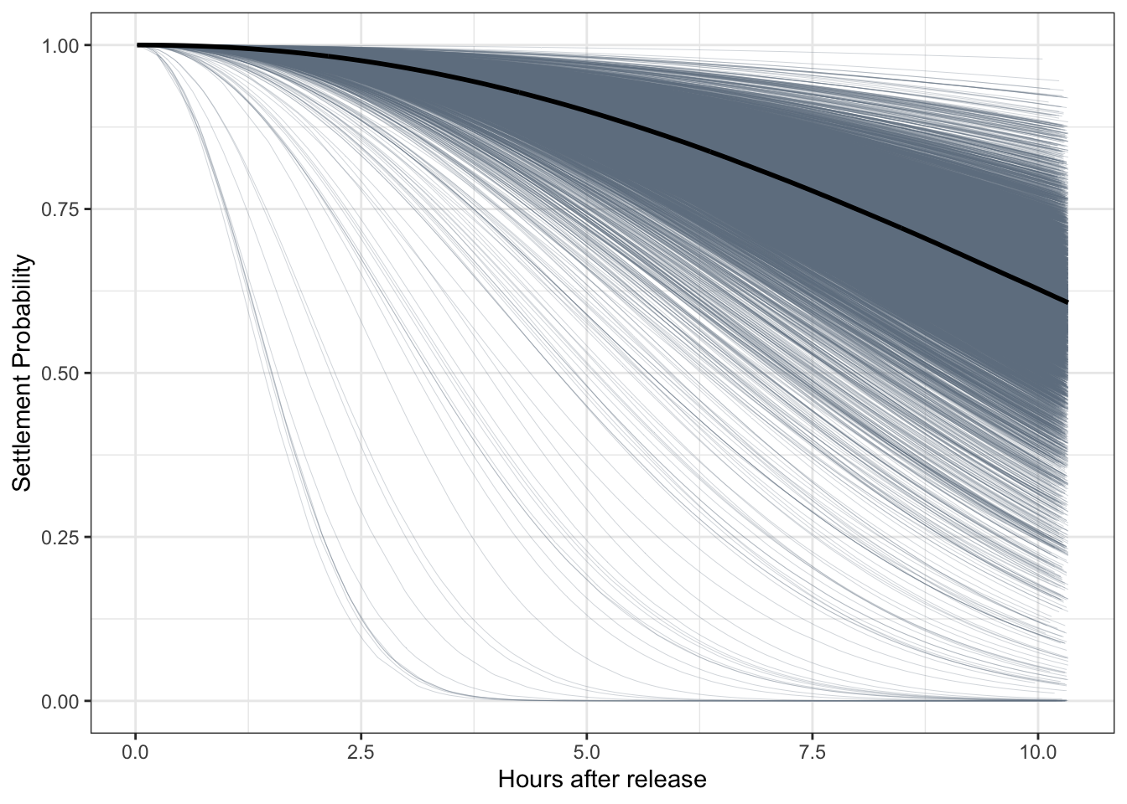
Larval reseeding
2) Where do larvae settle?
Notes:
In terms of upscaling larval restoration, the hydrodynamic models have been able to provide insight into one of the key questions of larval reseeding: where do larvae disperse following release?
From 10's of millions of larvae released onto damaged reefscduring free releases, how many settle in the immediate area and what are the spillover effects into adjacent habitats?
Where do larvae settle following release? This is important in terms of covnerting numbers of larvae into expected densities as a production rate, but ultiamtely quantifying the spatial footprtint of restoration.
To quantify this, we developed 'coralseed', a spatially explicit probabilistic model of larval settlement that leverages the high resolution dispersal models
So, coralseed is an individual based model, from smallscale simulations to large-scale modelling of releases
It's spatially explicit, incorporating habitat maps and larval particle tracks
It adopts a bayesian framework so is probabilitstic in terms of determining settlement outcomes
It's parameterised on field and experimental data collected during the RRAP program.
coralseed is split into four components: the underlying dispersal model, larval competency (how long after release are they ready to settle), a stochastic component of mortality (for example predation), and finally settlement success based upon where larvae track and probabilty of settlement.

Slide 7
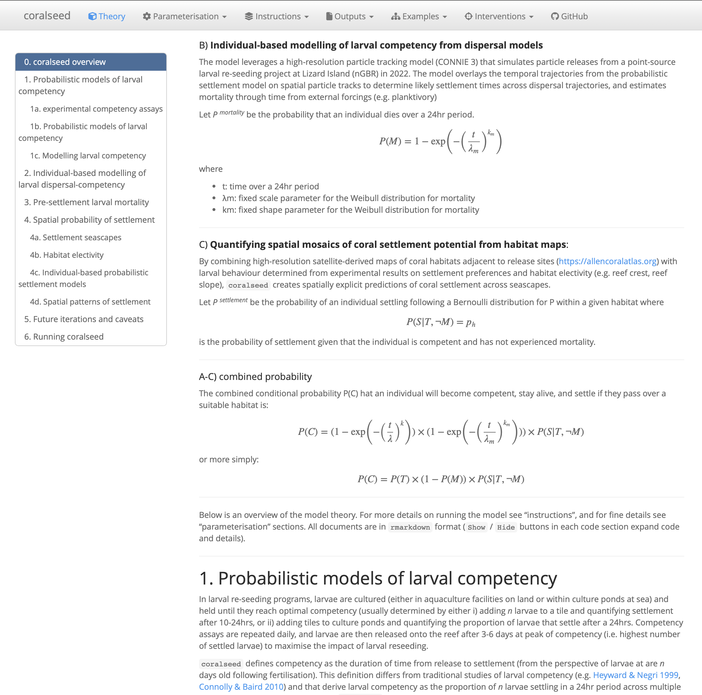
Larval reseeding
2) Where do larvae settle?
coralseed: a model of coral larval settlement
individual-based model (1,000 to 10,000,000 larvae)
spatially explicit
probabilistic model
parameterized on experimental and field data (RRAP)
https://marine-ecologist.github.io/coralseed/index.html
Notes:
In terms of upscaling larval restoration, the hydrodynamic models have been able to provide insight into one of the key questions of larval reseeding: where do larvae disperse following release?
From 10's of millions of larvae released onto damaged reefscduring free releases, how many settle in the immediate area and what are the spillover effects into adjacent habitats?
Where do larvae settle following release? This is important in terms of covnerting numbers of larvae into expected densities as a production rate, but ultiamtely quantifying the spatial footprtint of restoration.
To quantify this, we developed 'coralseed', a spatially explicit probabilistic model of larval settlement that leverages the high resolution dispersal models
So, coralseed is an individual based model, from smallscale simulations to large-scale modelling of releases
It's spatially explicit, incorporating habitat maps and larval particle tracks
It adopts a bayesian framework so is probabilitstic in terms of determining settlement outcomes
It's parameterised on field and experimental data collected during the RRAP program.
coralseed is split into four components: the underlying dispersal model, larval competency (how long after release are they ready to settle), a stochastic component of mortality (for example predation), and finally settlement success based upon where larvae track and probabilty of settlement.

Slide 8
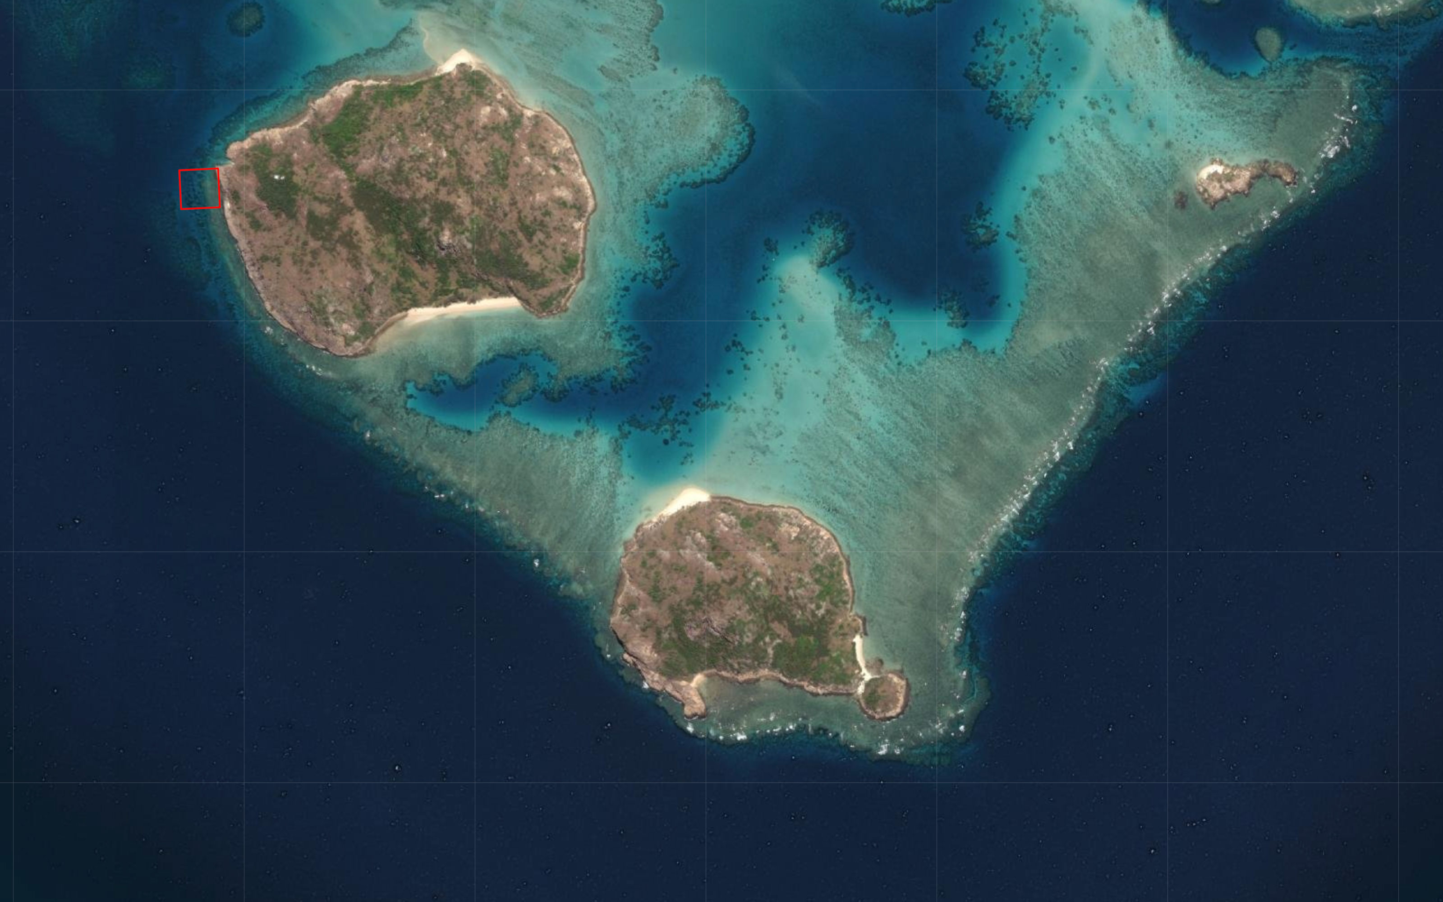
coralseed: example from Palfrey Reef, Lizard Island, northern GBR
Notes:
So, for example, here's Palfrey Reef at Lizard Island from simulations we ran back in 2022 before the mass coral spawning

Slide 9
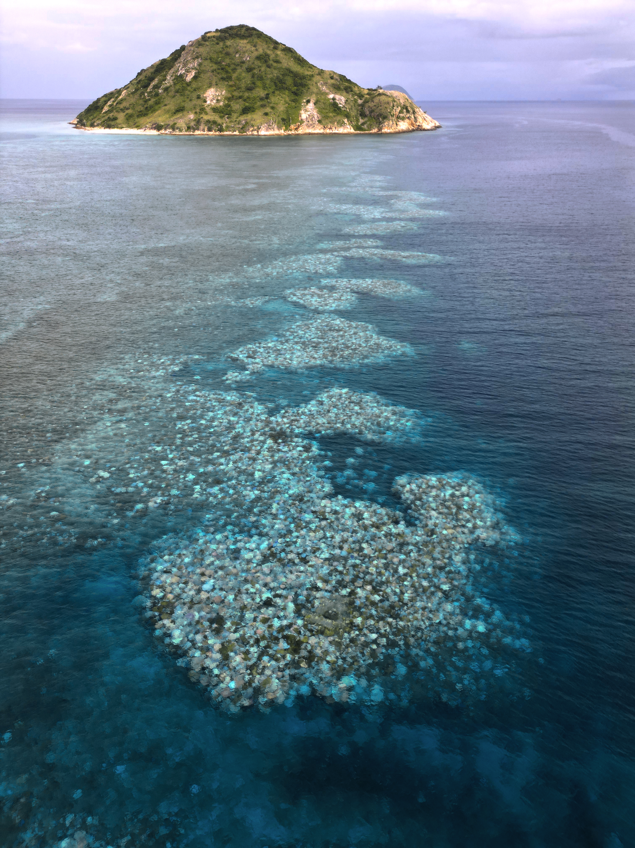
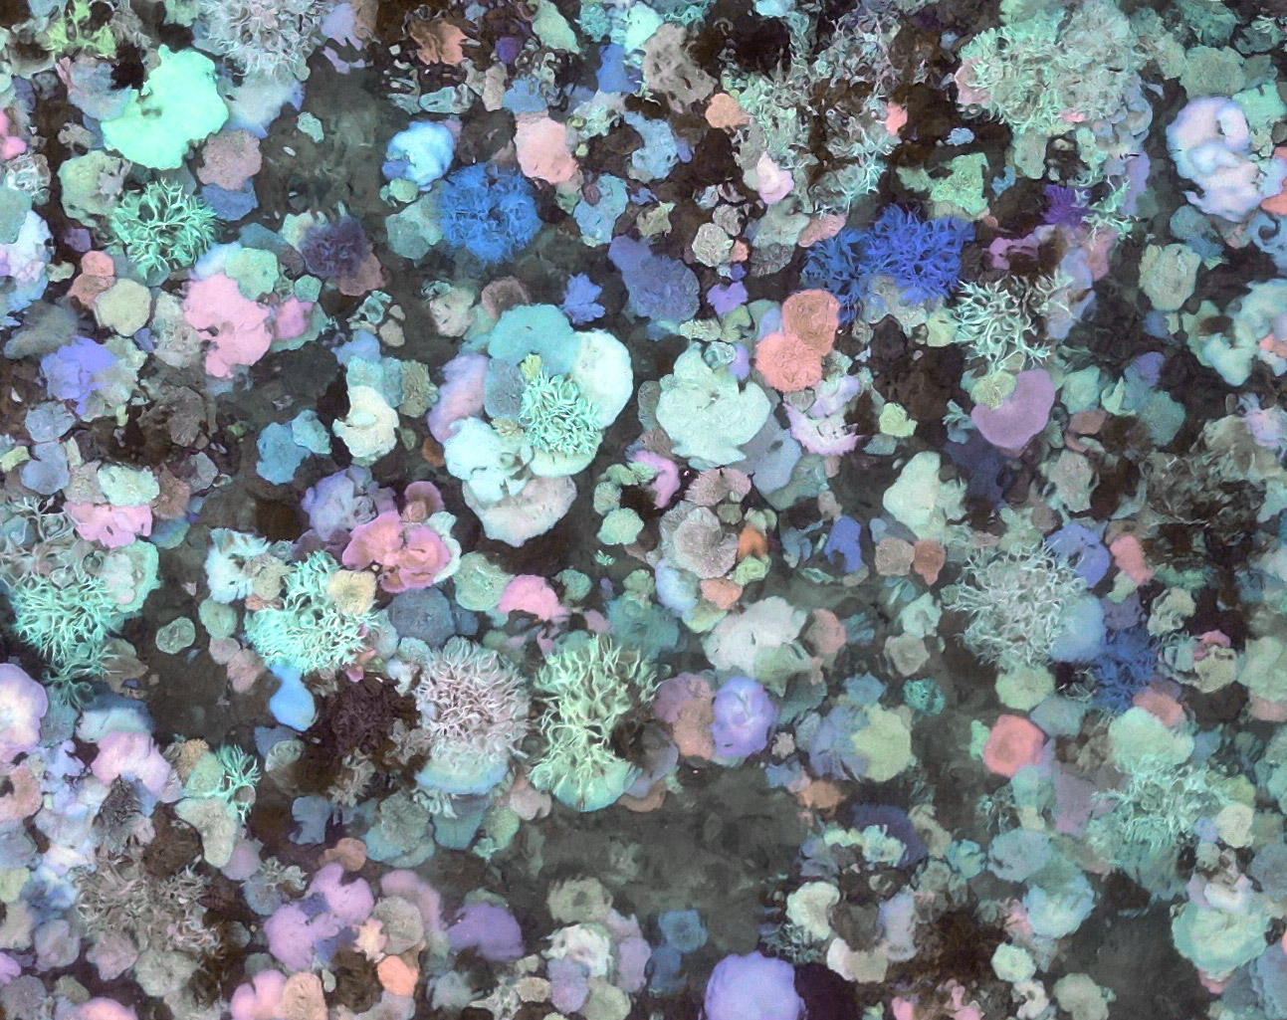
coralseed: example from Palfrey Reef, Lizard Island, northern GBR
March 19th 2024
March 19th 2024
Notes:
So, for example, here's Palfrey Reef at Lizard Island from simulations we ran back in 2022 before the mass coral spawning

Slide 10
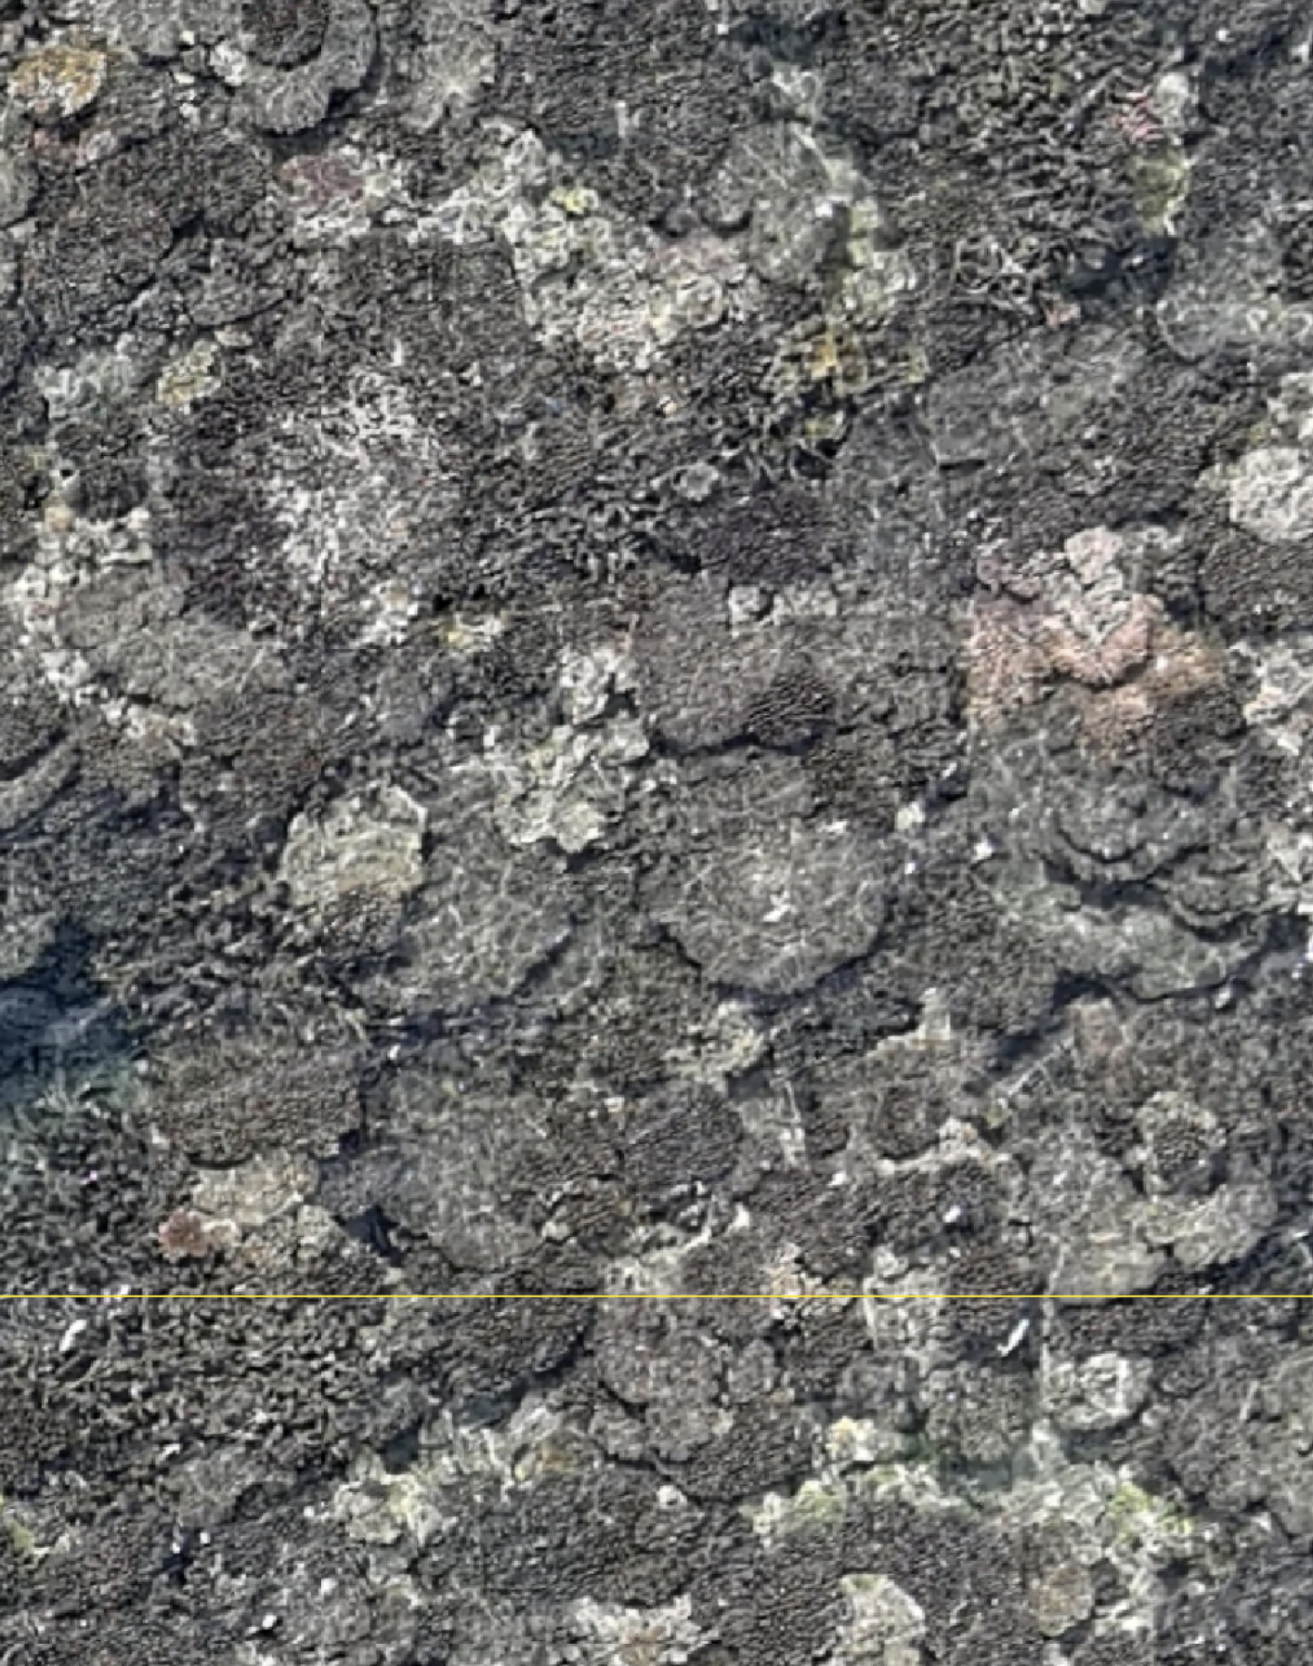
coralseed: example from Palfrey Reef, Lizard Island, northern GBR
March 19th 2024
March 19th 2024
June 15th 2024
Notes:
So, for example, here's Palfrey Reef at Lizard Island from simulations we ran back in 2022 before the mass coral spawning

Slide 11
coralseed: example from Palfrey Reef, Lizard Island, northern GBR
1ha restoration plot
Notes:
So, for example, here's Palfrey Reef at Lizard Island from simulations we ran back in 2022 before the mass coral spawning

Slide 12
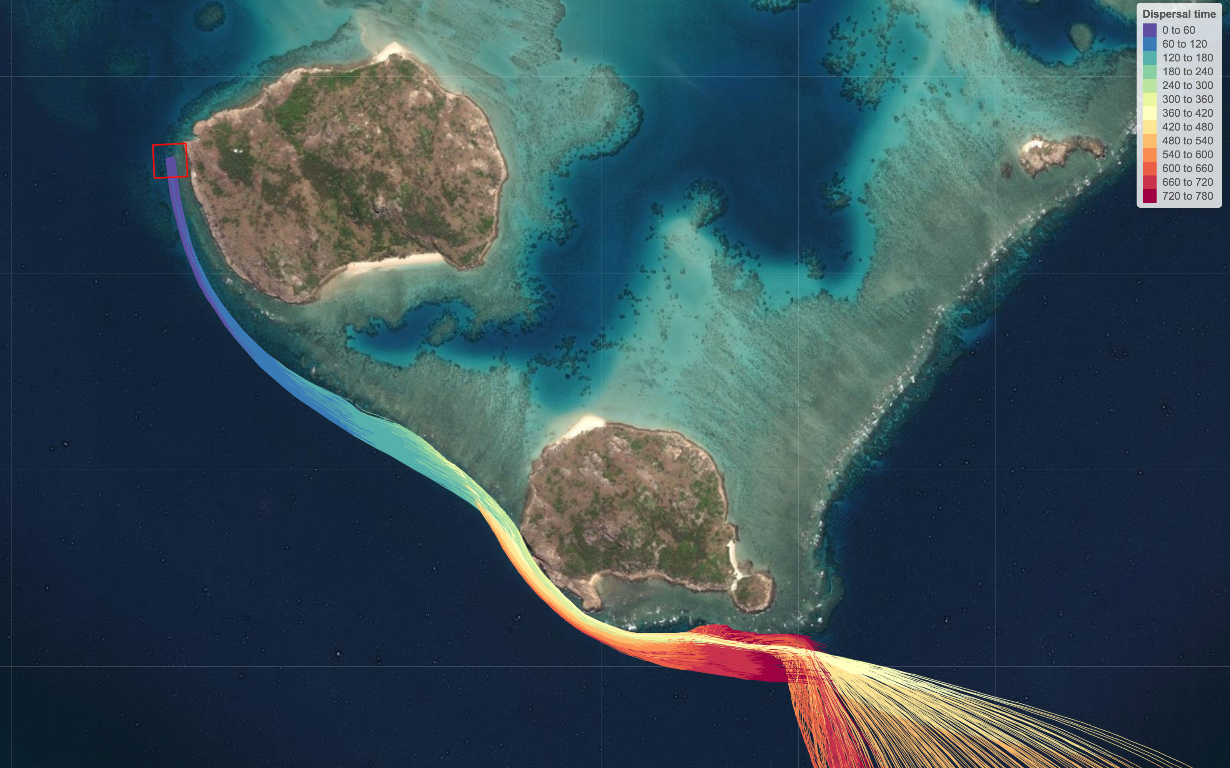
Dispersal paths (n = 1000 larvae)
Notes:
This little box in the top left is our release site and restoration hectare

Slide 13
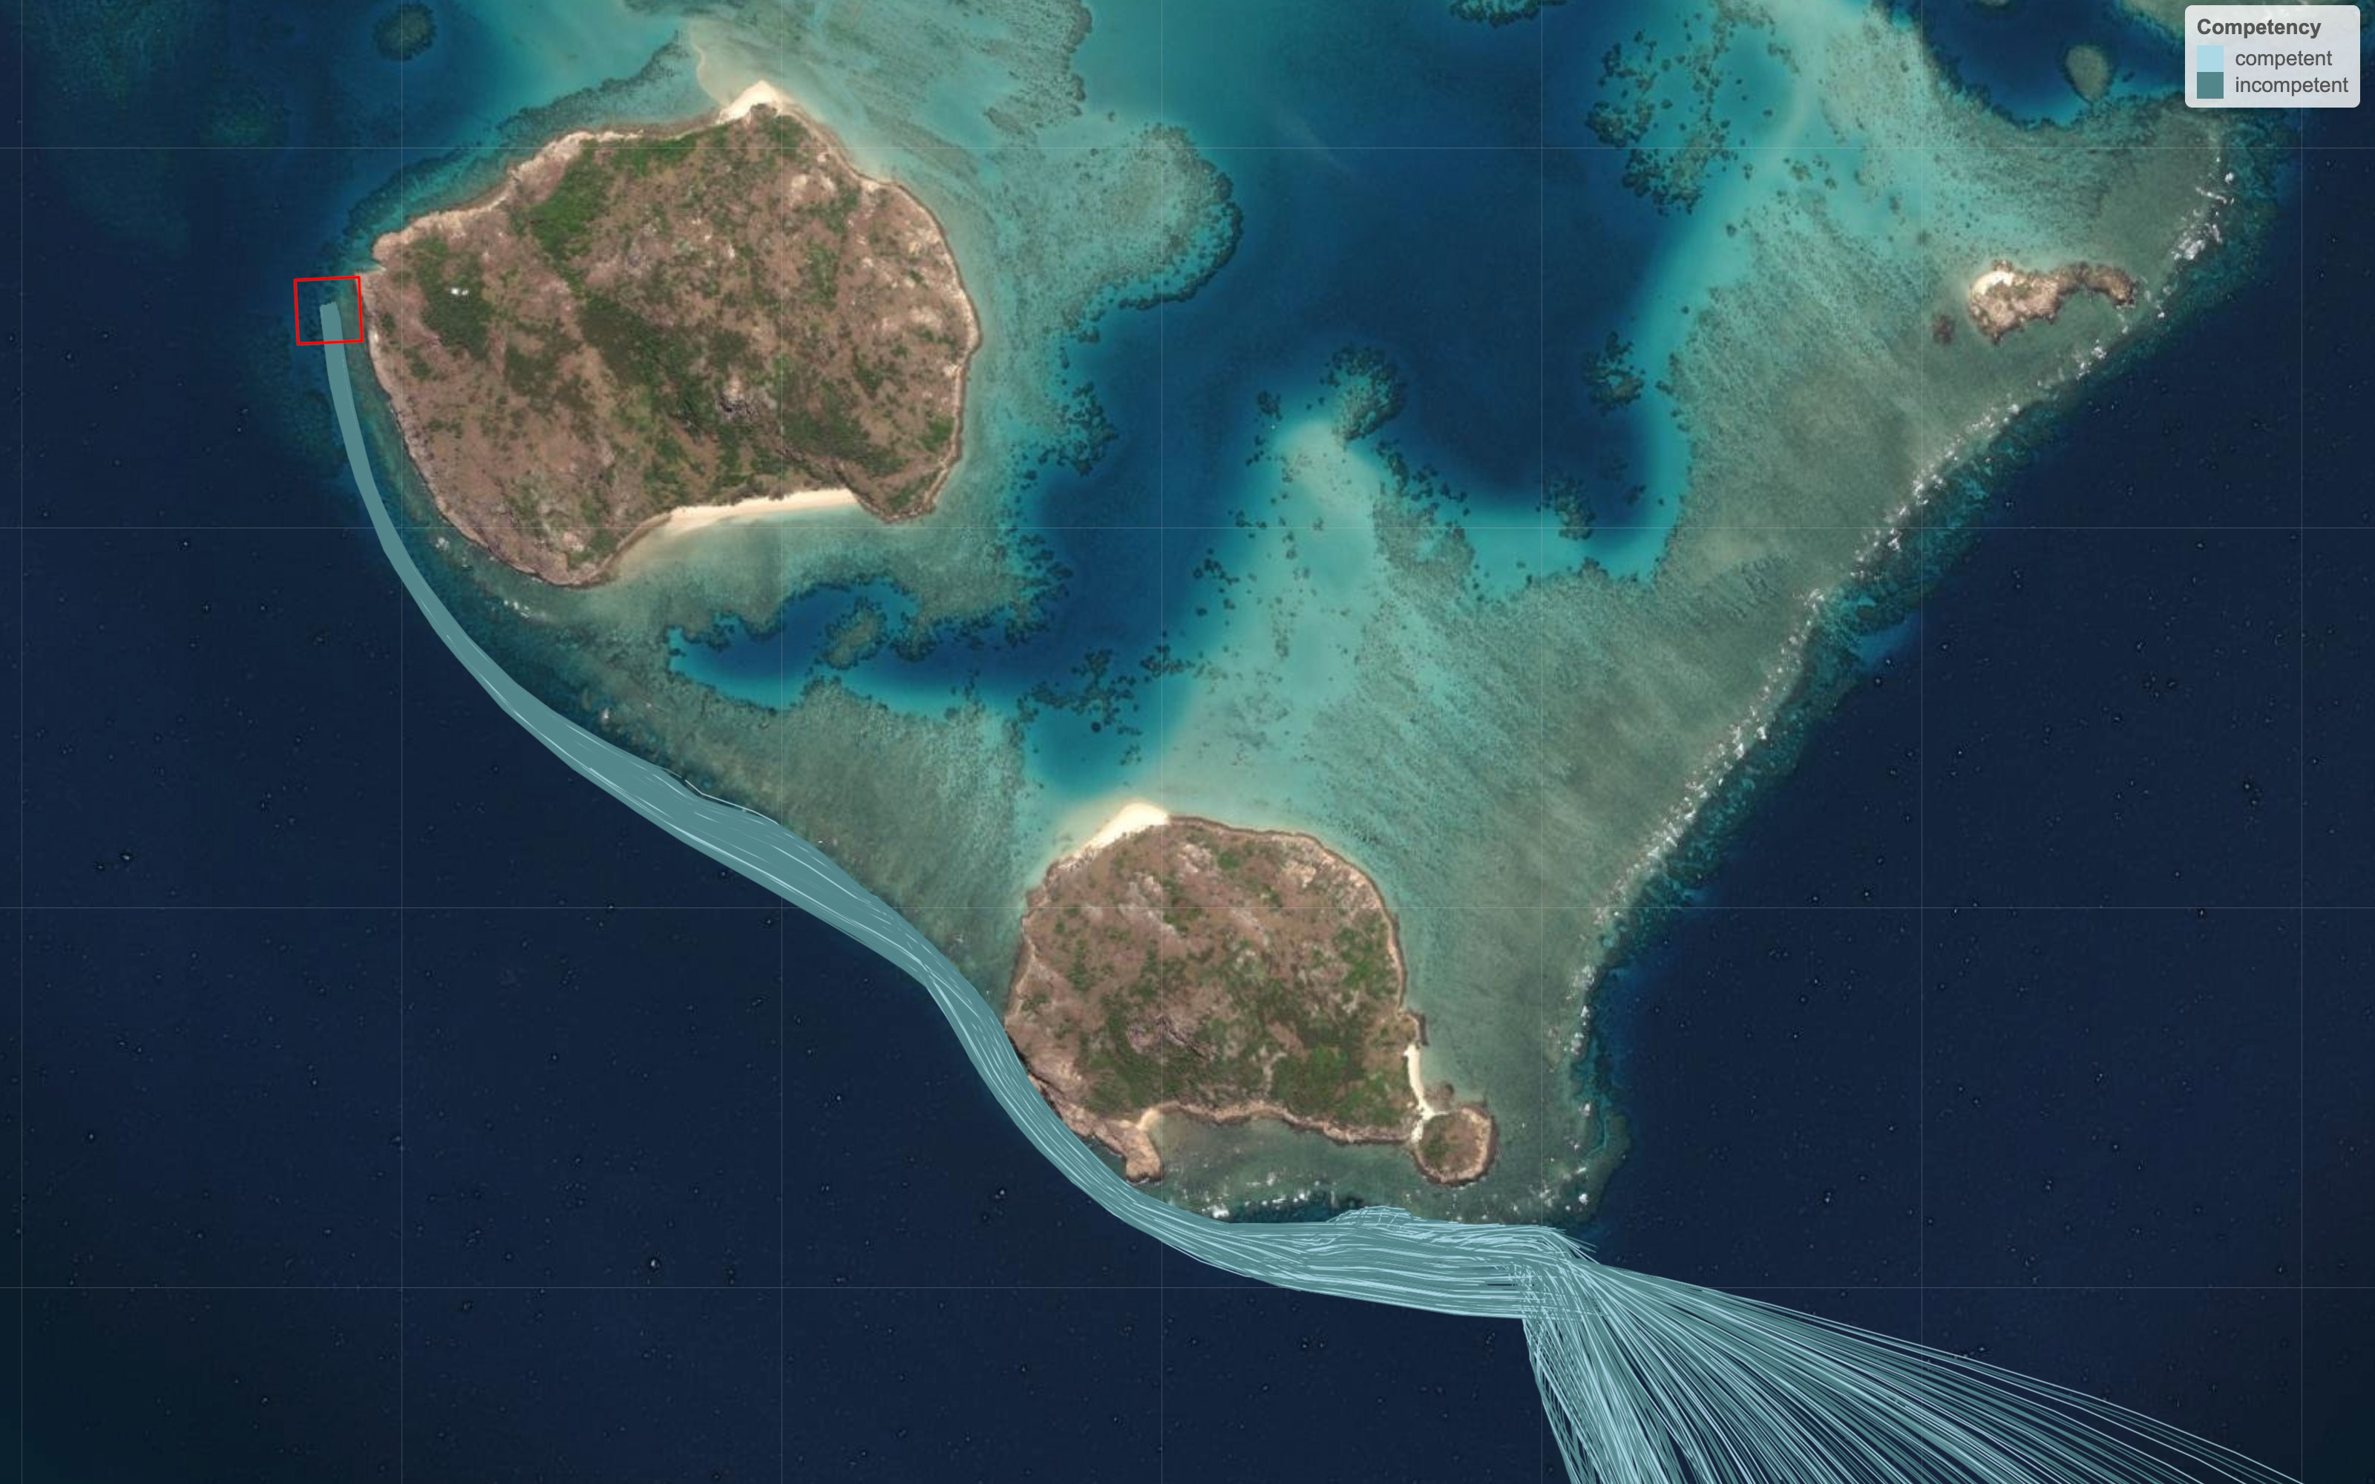
coralseed: example from Palfrey Reef, Lizard Island, northern GBR
Probability of competency
Larval dispersal paths (0-12hrs)
Notes:
This little box in the top left is our release site and restoration hectare

Slide 14
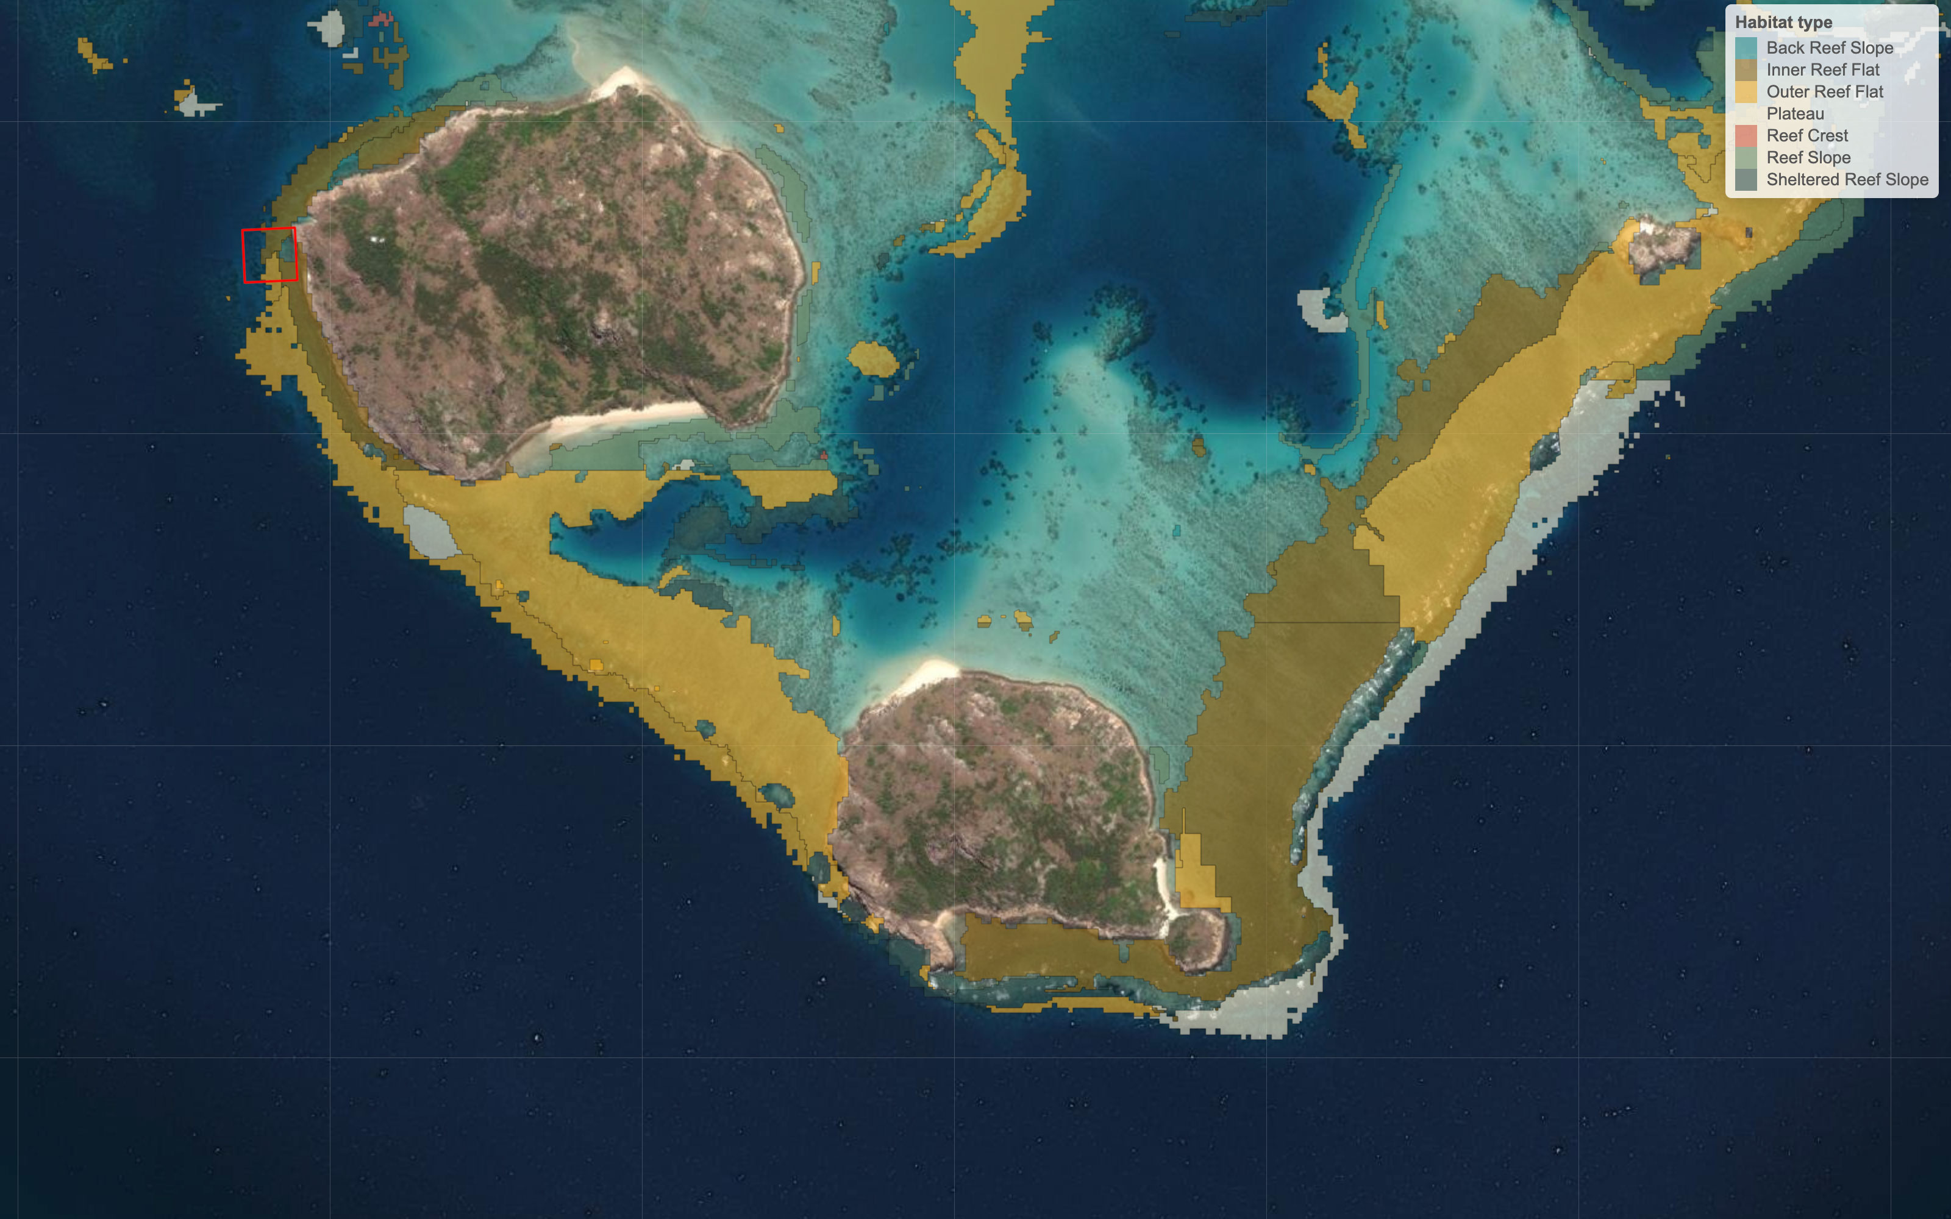
coralseed: example from Palfrey Reef, Lizard Island, northern GBR
Habitat maps
Spatial habitat mosaics (seascapes)
Notes:
The spatial component of the model is enhanced by using the allen coral atlas layers to determine seascape configurations of different habitats – forereef, back reef, and based upon larval electivity experiments each of these different habitats has a different probability of settlement for coral larvae based on larval preference

Slide 15
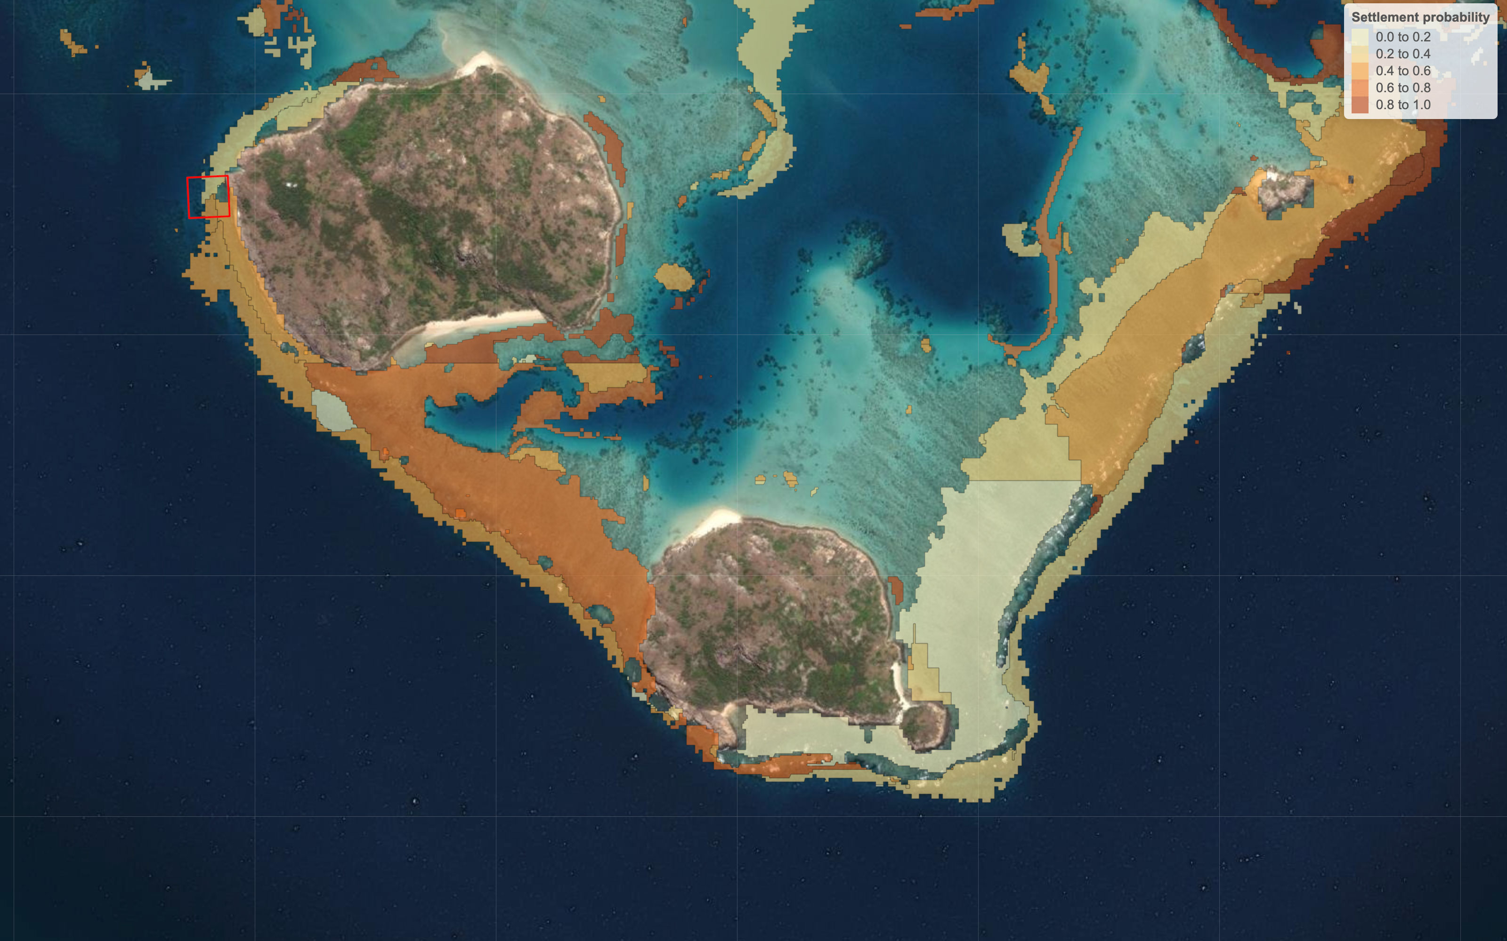
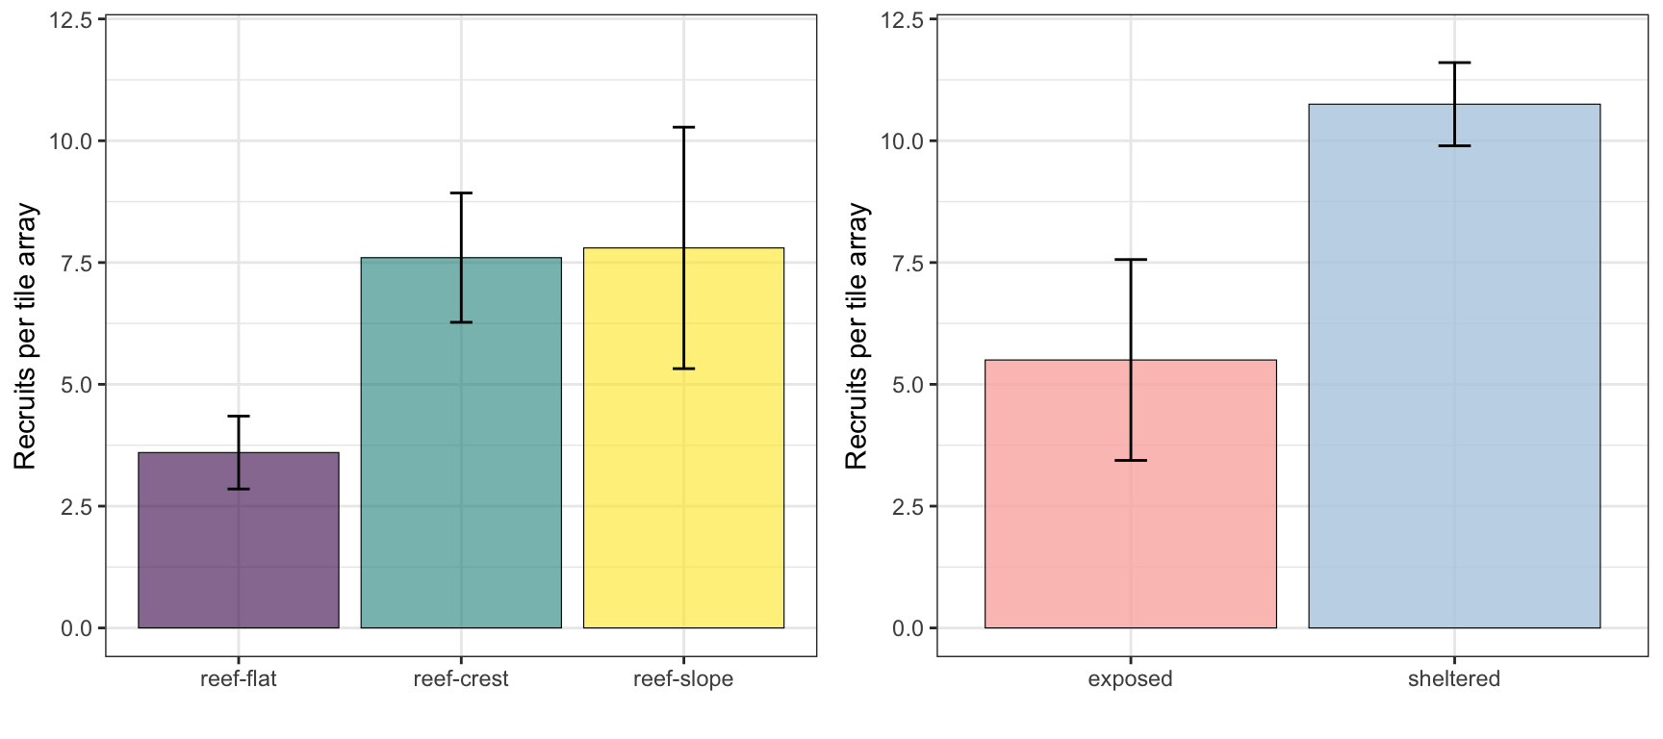
Habitat maps > settlement probability
Notes:
Turning these habitat maps into a mosaic of probability allows us to generate spatial mosaics of settlement probability, where in this map the darker colours represent a higher probability of settlement

Slide 16
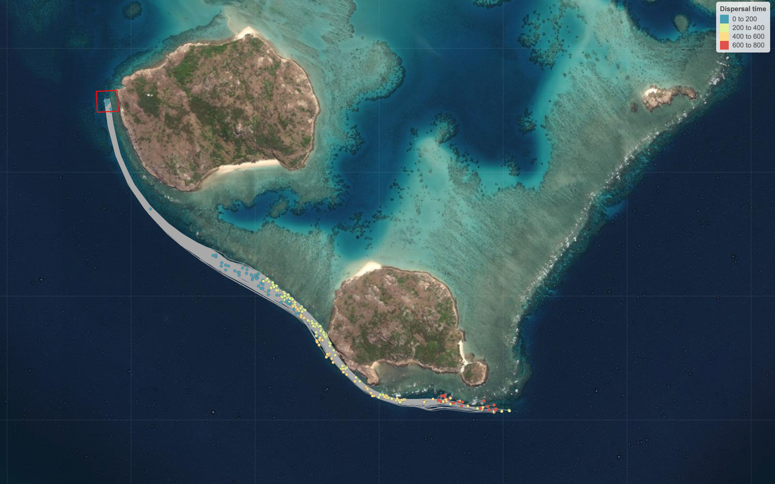
coralseed: example from Palfrey Reef, Lizard Island, northern GBR
Larval settlement
Spatial patterns of settlement
Notes:
Which allows us to combine probability to determine the spatial locations of larvae that settled on the reef and the proportion of larvae that were diluted and lost to large-scale off-reef dispersal.

Slide 17
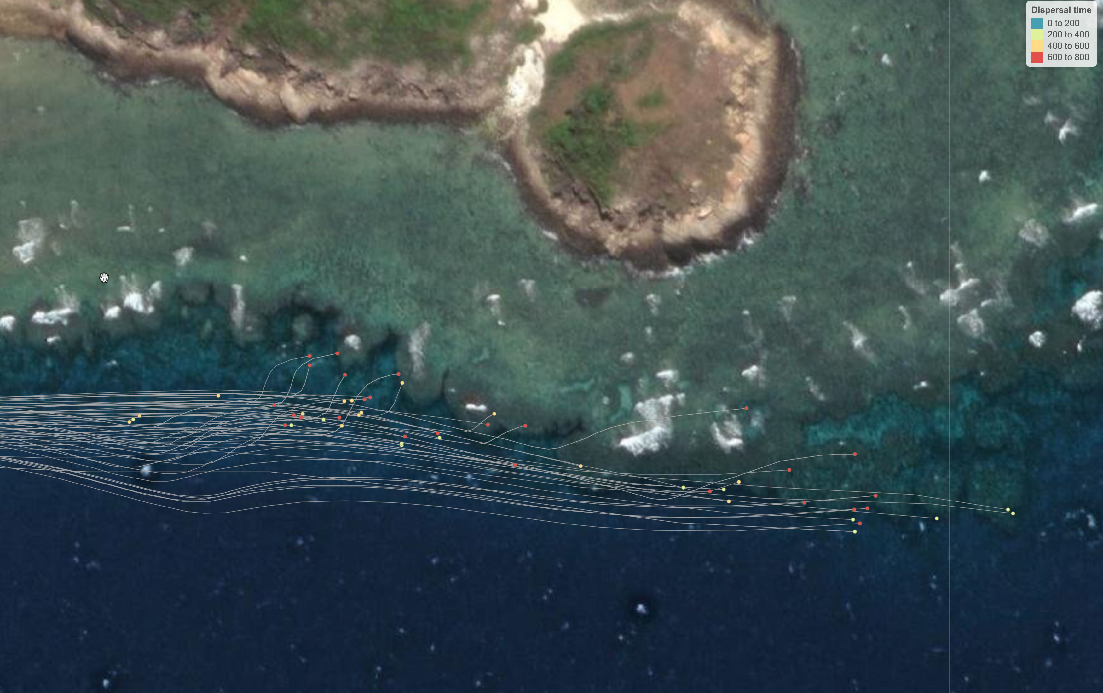
coralseed: example from Palfrey Reef, Lizard Island, northern GBR
Notes:
Here's an example of the finescale settlement patterns on the south of Palfrey Island

Slide 18
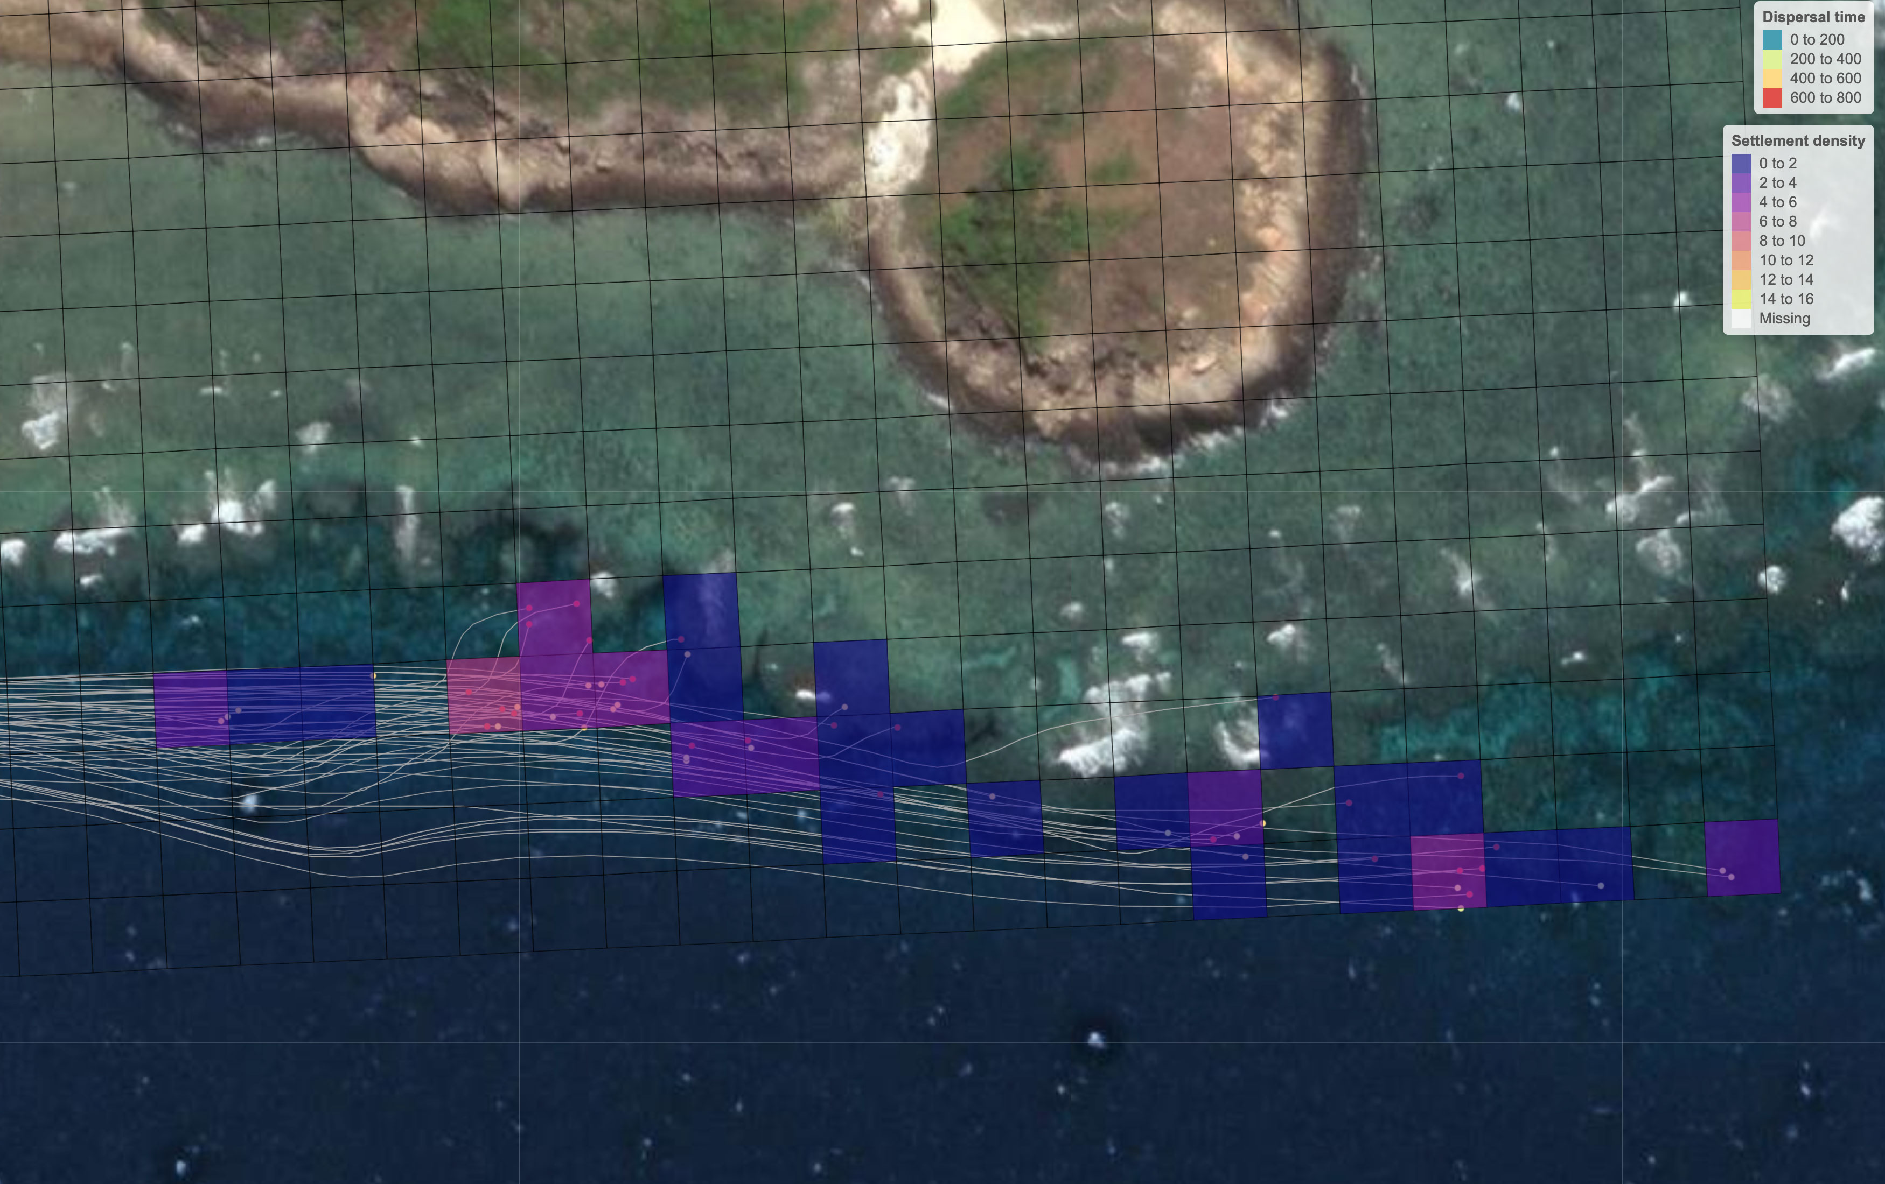
coralseed: example from Palfrey Reef, Lizard Island, northern GBR
Settlement statistics: settlement densities
Notes:
and one of the benefits of spatially explicit models is that we can then quantify not only the total numbers of larvae settled, but also the underlying spatial patterns such as settlement density

Slide 19
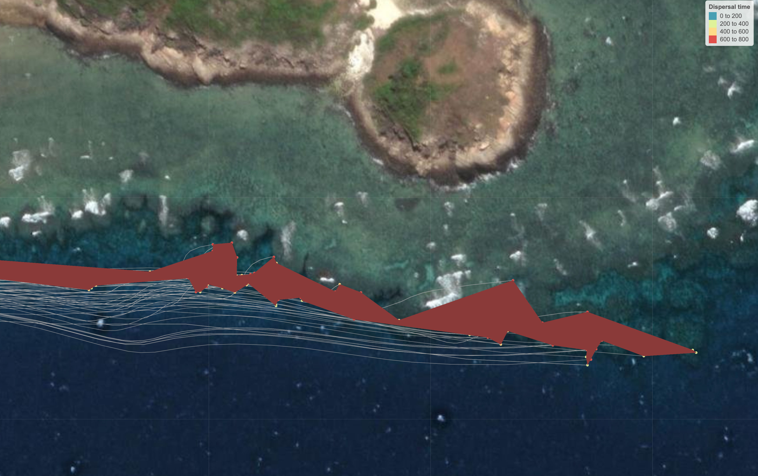
coralseed: example from Palfrey Reef, Lizard Island, northern GBR
Settlement statistics: restoration area
Notes:
and spatial footprint of settlement, allowing evaluation of the impact and scale of these reseeding programs for the first time.

Slide 20
Coralseed – next steps
Testable framework for detecting larvae in field deployments
Notes:
we've been trying to understand how additional interventions can improve on investment and return. For example
how optimising releases at slack tides can enhance densities and reduce spillover to adjacent habitats
how enhanced larval retention through the use of bubble curtains to entrap larvae or act as barriers can restrict dispersal, in turn enhancing settlement
or how incubating larvae in inducers such as coralline algae prior to release may reduce competency times and accelerate settlement
finally how timed delayed releases can improve settlement densities by releasing larvae when they are competent to settle immediately following release.

Slide 21
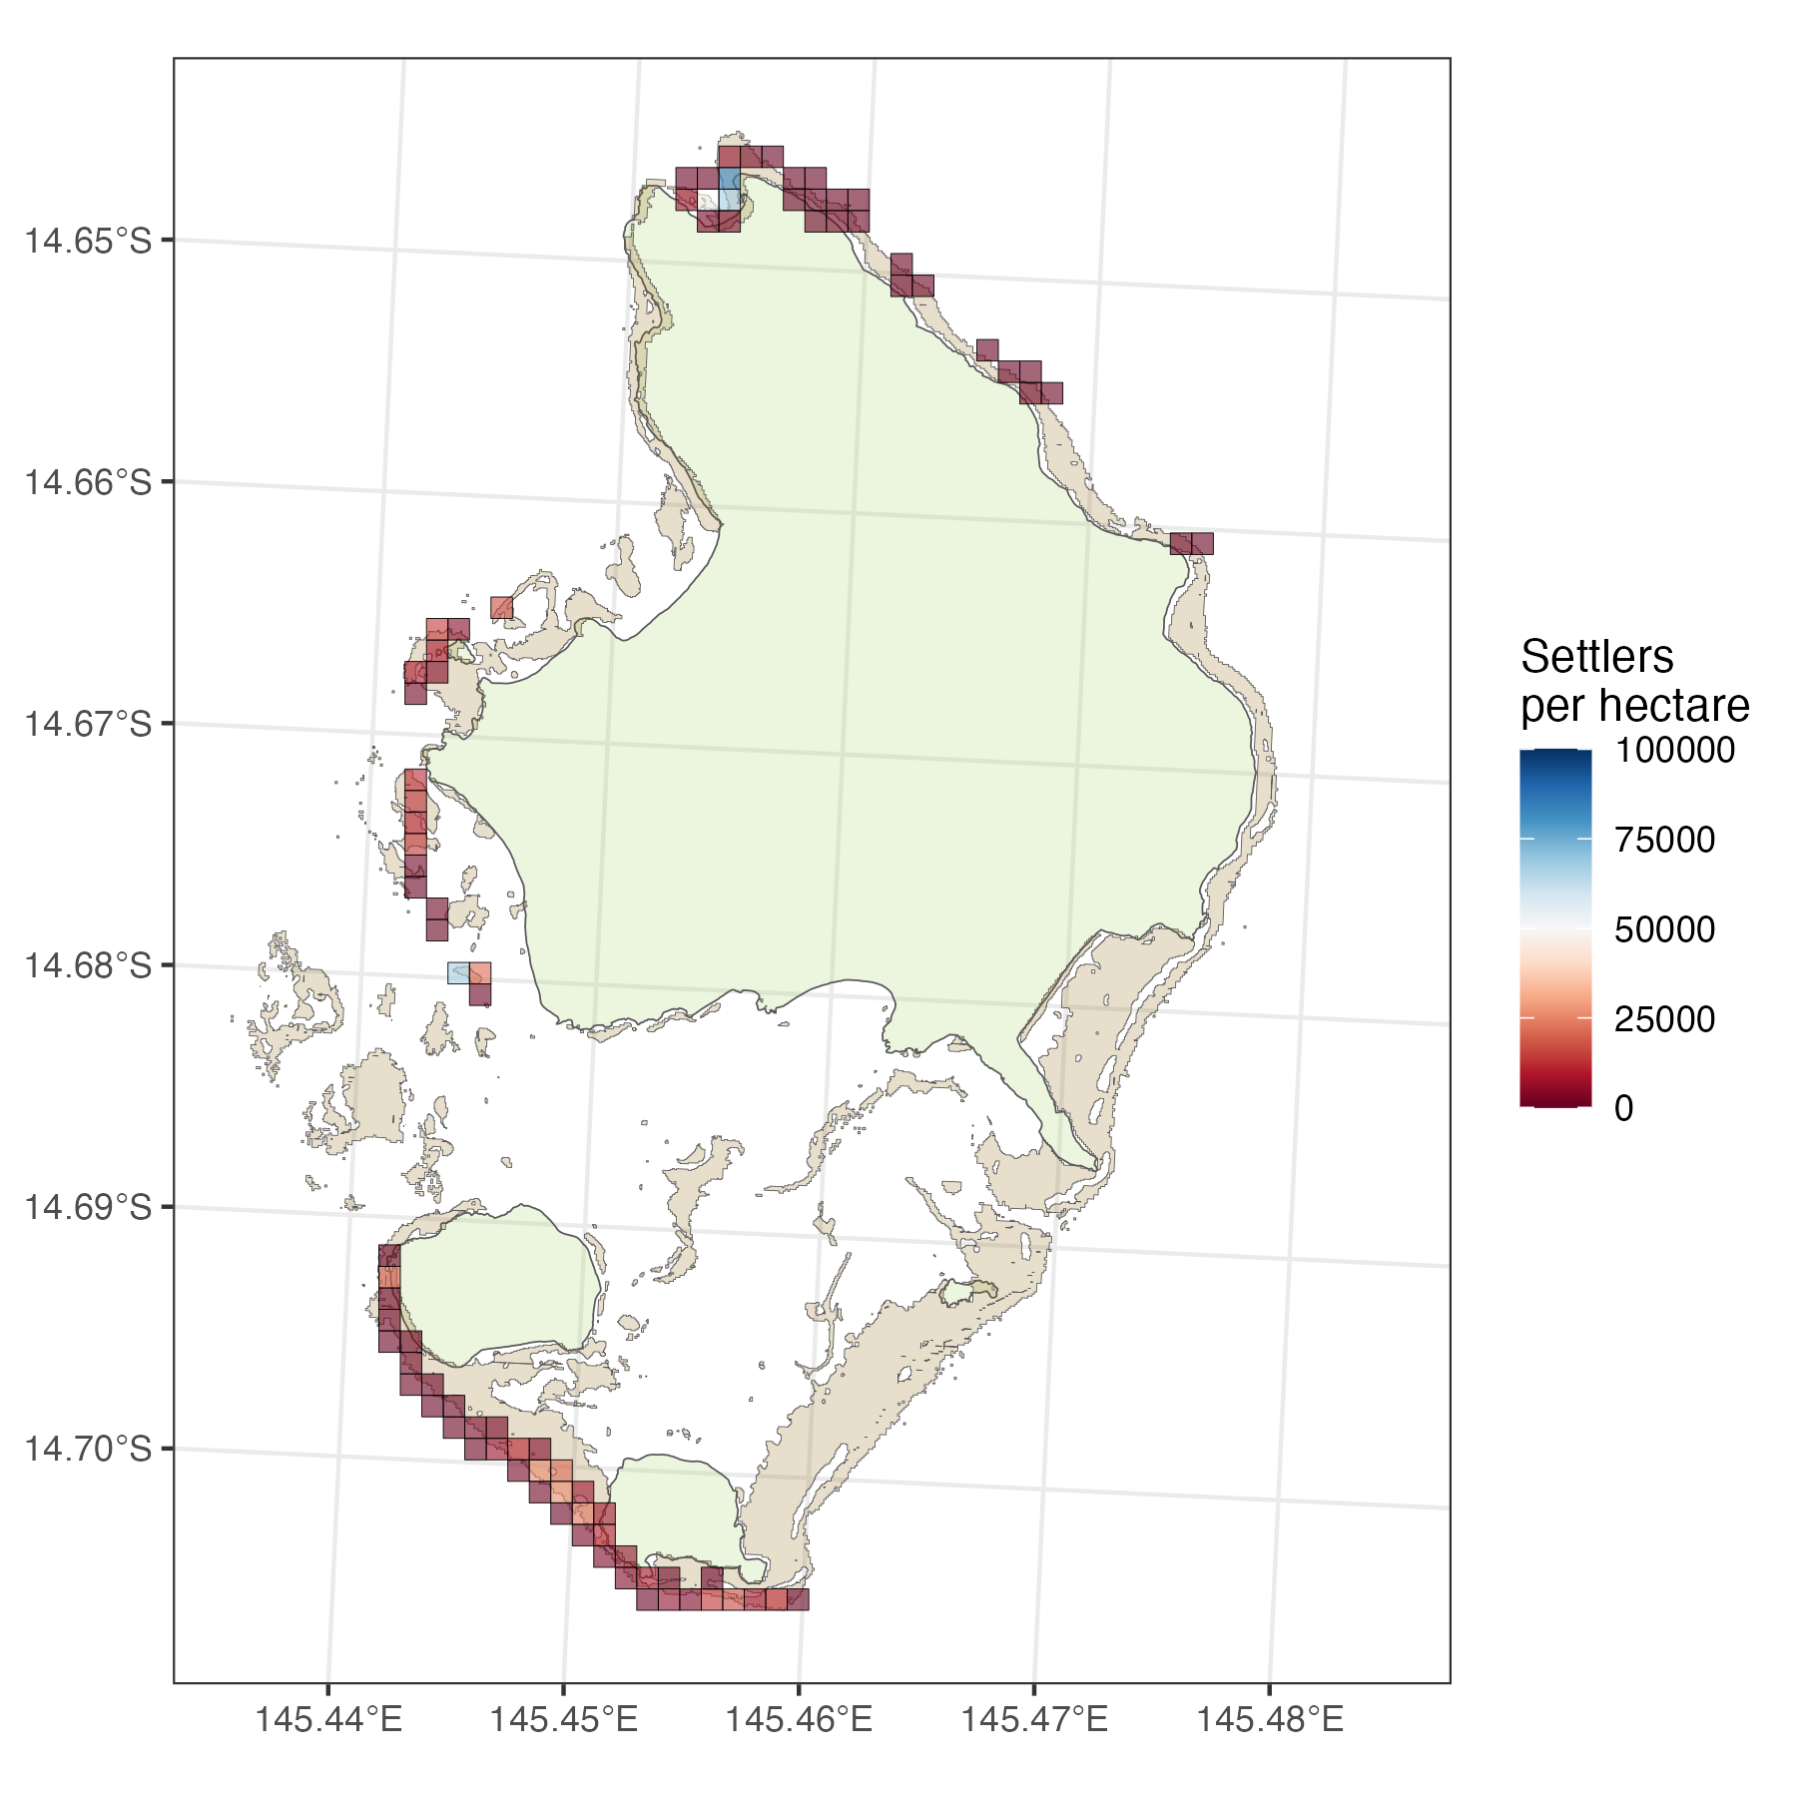
Coralseed – next steps
Testable framework for detecting larvae in field deployments
Simulating large-scale releases (100+ million larvae)
Notes:
we've been trying to understand how additional interventions can improve on investment and return. For example
how optimising releases at slack tides can enhance densities and reduce spillover to adjacent habitats
how enhanced larval retention through the use of bubble curtains to entrap larvae or act as barriers can restrict dispersal, in turn enhancing settlement
or how incubating larvae in inducers such as coralline algae prior to release may reduce competency times and accelerate settlement
finally how timed delayed releases can improve settlement densities by releasing larvae when they are competent to settle immediately following release.

Slide 22
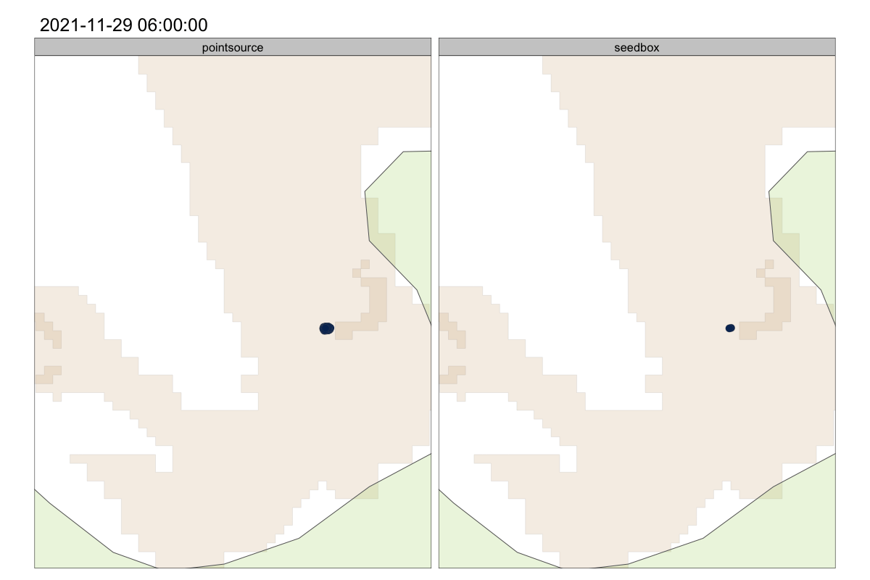
Coralseed – next steps
Testable framework for detecting larvae in field deployments
Simulating large-scale releases (100+ million larvae)
Optimising outcomes
Time-delayed releases
Notes:
we've been trying to understand how additional interventions can improve on investment and return. For example
how optimising releases at slack tides can enhance densities and reduce spillover to adjacent habitats
how enhanced larval retention through the use of bubble curtains to entrap larvae or act as barriers can restrict dispersal, in turn enhancing settlement
or how incubating larvae in inducers such as coralline algae prior to release may reduce competency times and accelerate settlement
finally how timed delayed releases can improve settlement densities by releasing larvae when they are competent to settle immediately following release.

Slide 23
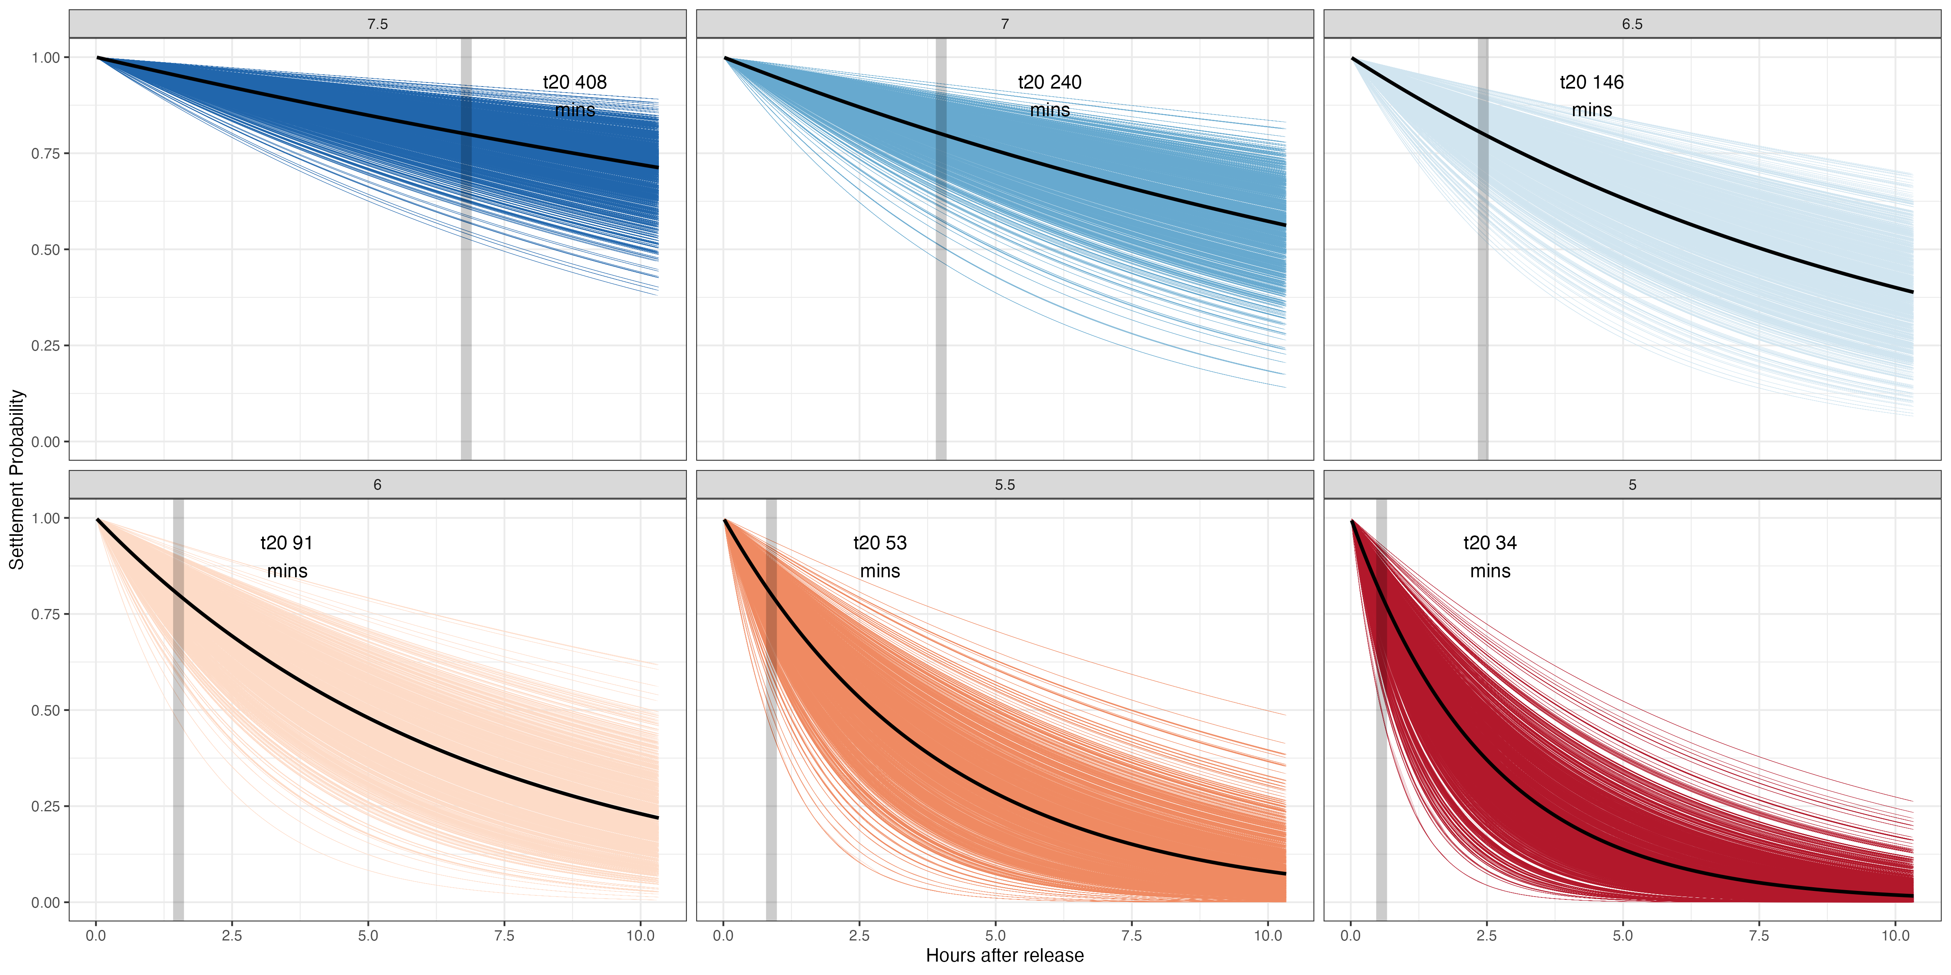
Coralseed – next steps
Testable framework for detecting larvae in field deployments
Simulating large-scale releases (100+ million larvae)
Optimising outcomes
Time-delayed releases
Enhanced larval competency
Notes:
we've been trying to understand how additional interventions can improve on investment and return. For example
how optimising releases at slack tides can enhance densities and reduce spillover to adjacent habitats
how enhanced larval retention through the use of bubble curtains to entrap larvae or act as barriers can restrict dispersal, in turn enhancing settlement
or how incubating larvae in inducers such as coralline algae prior to release may reduce competency times and accelerate settlement
finally how timed delayed releases can improve settlement densities by releasing larvae when they are competent to settle immediately following release.

Slide 24
Coralseed – next steps
Testable framework for detecting larvae in field deployments
Simulating large-scale releases (100+ million larvae)
Optimising outcomes
Time-delayed releases
Enhanced larval competency
Cost-benefit / return on investment
Cost per larvae / settler
Cost per 1yr old colony
Notes:
we've been trying to understand how additional interventions can improve on investment and return. For example
how optimising releases at slack tides can enhance densities and reduce spillover to adjacent habitats
how enhanced larval retention through the use of bubble curtains to entrap larvae or act as barriers can restrict dispersal, in turn enhancing settlement
or how incubating larvae in inducers such as coralline algae prior to release may reduce competency times and accelerate settlement
finally how timed delayed releases can improve settlement densities by releasing larvae when they are competent to settle immediately following release.

Slide 25
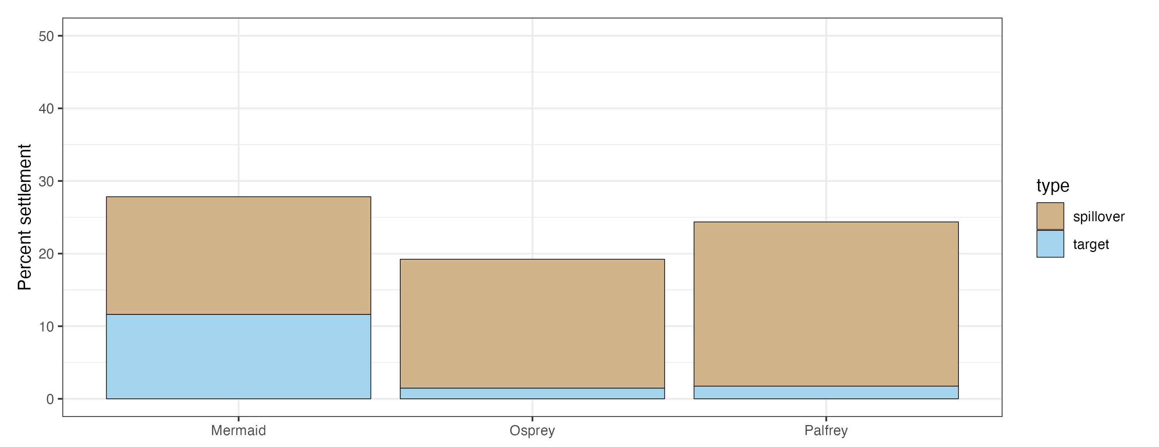
Coralseed – next steps
Testable framework for detecting larvae in field deployments
Simulating large-scale releases (100+ million larvae)
Optimising outcomes
Time-delayed releases
Enhanced larval competency
Cost-benefit / return on investment
Cost per larvae / settler
Cost per 1yr old colony
Larval spillover effects
Notes:
we've been trying to understand how additional interventions can improve on investment and return. For example
how optimising releases at slack tides can enhance densities and reduce spillover to adjacent habitats
how enhanced larval retention through the use of bubble curtains to entrap larvae or act as barriers can restrict dispersal, in turn enhancing settlement
or how incubating larvae in inducers such as coralline algae prior to release may reduce competency times and accelerate settlement
finally how timed delayed releases can improve settlement densities by releasing larvae when they are competent to settle immediately following release.

